Slide 1
Biology I
K. Maltz
Cell Growth and Division

Slide 2
Reproduction
There are 2 ways in which organisms can reproduce
Asexual reproduction- offspring are genetically identical to parent
Sexual reproduction- offspring are genetically DIFFERENT than both parents
Organisms can reproduce asexually, sexually, or both ways
There are advantages to each type
Asexual reproduction- large number of organisms in a short period of time
Sexual- GENETIC DIVERSITY(offspring may be better adapted to their environment)

Slide 3
Cell Division Background
Cell division is all about copying and dividing genetic information
DNA is packaged and stored as a chromosome
Prokaryotes usually have 1 piece of circular DNA
In order to reproduce (asexually) they undergo a process known as binary fission
In binary fission, the DNA duplicates (copies), the cell membrane indents, and the cell divides into 2 new cells
These 2 new cells are genetically identical to the parent cell

Slide 4
Who’s Who of DNA
1928- Frederick Griffith- something is transferred from rough to smooth strain
1945 Oswald Avery- That “something” is DNA!
1944-50 Erwin Chargaff- Chargaff’s Rules of Base Pairing (A bonds with T and C bonds with G)
1951- Rosalind Franklin- structure of DNA via X-Ray crystallography
1952 A.D. Hershey/ Martha Chase- proof that the “something” was DNA
1953- Francis Watson and James Crick- credited with discovering structure of DNA (double helix)

Slide 5
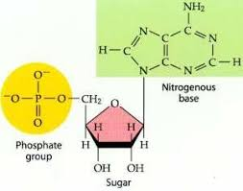
DNA in Eukaryotes
In eukaryotic organisms, there are MANY pieces of DNA (46 individual pieces in humans)
These pieces of DNA need to be copied and packaged in a specific way
Remember DNA is made of monomers called nucleotides

Slide 6
DNA
These nucleotides form COVALENT BONDS with one another in a strand
2 strands come together and twist into the “double helix” shape with the sugar/phosphate groups on the outside and the nitrogenous bases on the inside that form HYDROGEN BONDS
Each double helix strand of DNA pairs with a number of proteins called histones that attach to the DNA
The DNA coils around the histones in sections to form nucleosomes

Slide 7
DNA
Genetic material inside a cell serves 4 essential functions:
Stores enough genetic material to construct an entire organism
Copies accurately
Can pass from parent to offspring
Accounts for the known variation within and among species
Chromosomes- cellular structures that contain genetic material; contain both DNA itself and proteins

Slide 8
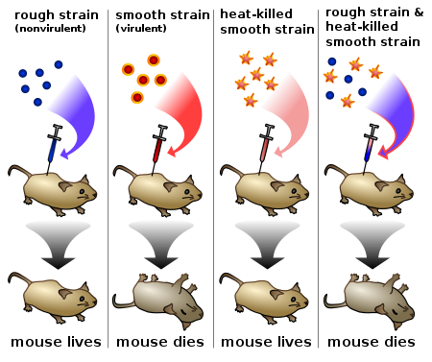
Griffith Experiment
Notes:
Frederick Griffith
Streptococcus Pneumoniae
Smooth strain secrete a capsule
First injected each strain individually
Then used heat to kill the smooth and injected it
Why did the mouse die?
Griffith thought that a substance inside the smooth strain was making the rough strain form capsules
We now know this process is called bacterial transformation

Slide 9
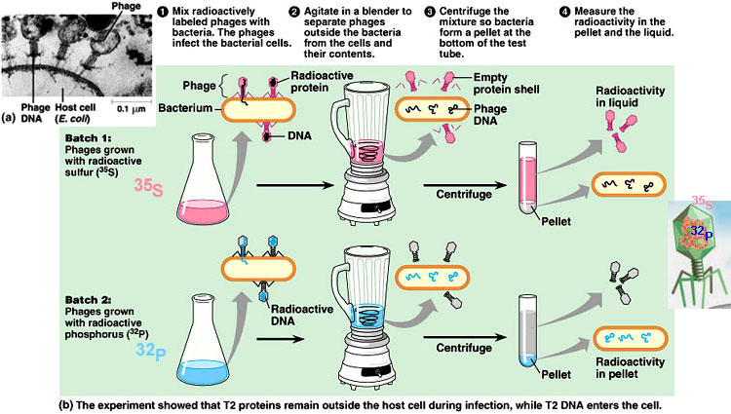
Hershey/Chase Experiment
Notes:
Alfred Hershey and Martha Chase
Used 35 Sulfer to label proteins
Use 32 Phosphorus to label DNA inside T2 phages

Slide 10
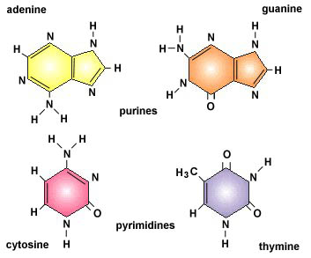
Nucleotide Structure: DNA

Slide 11
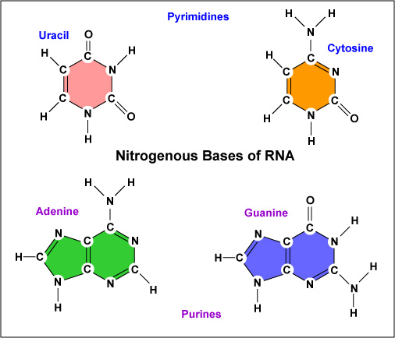
Nucleotide Structure: RNA

Slide 12
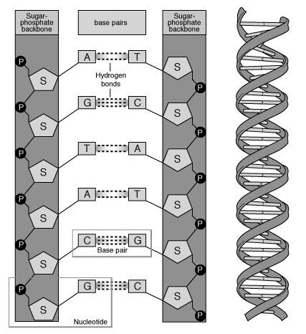
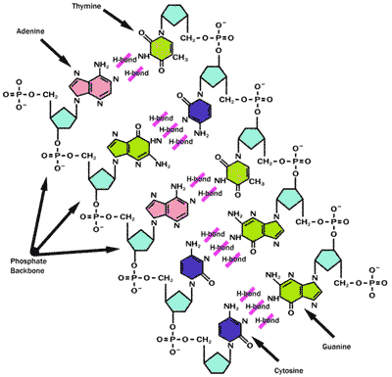
DNA Structure

Slide 13
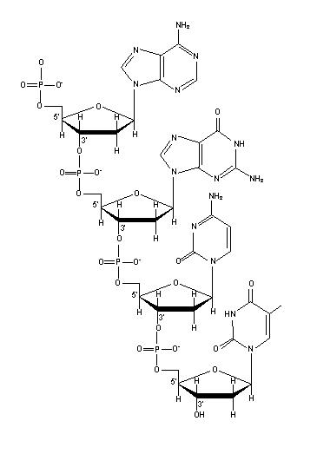
Linkage
Notes:
5 prime end, 3 prime end- sugar is numbered using prime designation

Slide 14
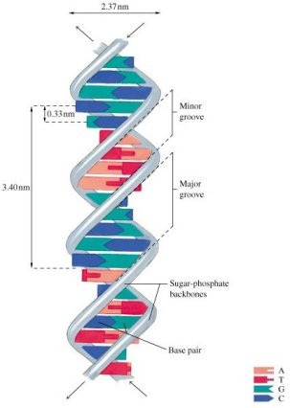
Double Helix Conformation
Notes:
Major groove, minor groove, 10 BP per turn

Slide 15
Ingredients for DNA Replication
Protein | Function
DNA Helicase | Separates DNA into single strand
Single-Strand Binding Protein | Binds to strand and prevents re-binding
Topoisomerase | Loosens tightened coils ahead of replication fork
DNA Primase | Makes small RNA primers
DNA Polymerase | Synthesizes DNA , removes RNA primers, repairs DNA, fills in gaps
DNA Ligase | Attaches Okazaki fragments
Notes:
What phase of the cell cycle does DNA replication occur?

Slide 16
DNA Replication
Notes:
Helicases form replication fork at the section of DNA to be copied

Slide 17
From DNA to Chromosomes
The nucleosomes bundle and twist together to form chromatin
When the cell is ready to divide, the chromatin packs together even further into superocoiled chromatin and then a chromatid
Two identical chromatids (formed when DNA replicates) pair to form a chromosome and attached together by a centromere

Slide 18
From DNA to Chromosomes
Sister chromatid
Sister chromatid

Slide 19
Cell Cycle
The cell spends most of its life growing and performing regular cell duties in a phase called G1
When the cell is ready to divide, DNA copies, or replicates in a phase called S phase
Final preparations are made for division in a third phase called G2
Together, G1, S, and G2 are known as interphase
After interphase completes, mitosis (M-phase) begins

Slide 20
Cell Cycle

Slide 21
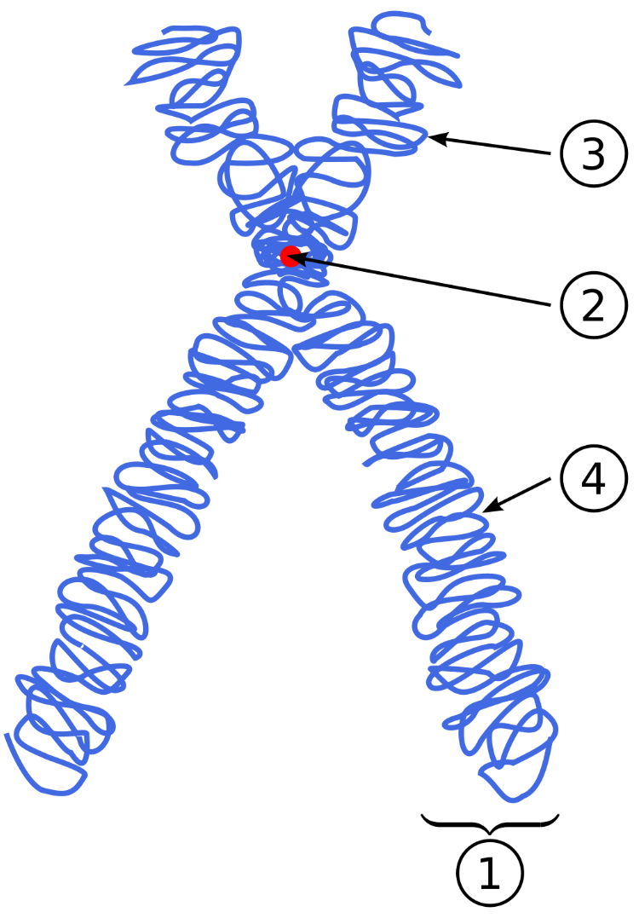
Recall: Important Cell Parts

Slide 22
Mitosis
Mitosis- division of sister chromatids to yield two genetically identical nuclei
In other words: after we copy the DNA, we must split the copies so each cell gets its own copy!
4 steps of Mitosis
Prophase
Metaphase
Anaphase
Telophase

Slide 23
Prophase
DNA condenses into chromosomes
Centrioles migrate to opposite sides
Spindle begins to form

Slide 24
Prophase (contd.)
Nucleus and Nucleolus break down
Spindle microtubules attach to sister chromatids
Some spindle fibers may remain free

Slide 25
Metaphase
Spindle microtubules push and pull chromosomes to align them down the center of the cell

Slide 26
Anaphase
Sister chromatids are pulled apart and centromere is broken
Unattached fibers lengthen to stretch cell

Slide 27
Telophase
Nucleus and nucleolus re-form
Chromosomes unwind

Slide 28
Cytokinesis
Cytokinesis- yields 2 daughter cells
Slightly different in plants and animals
Animal cells simply pinch in to create a cleavage furrow
Plants have a cell wall
To separate the 2 cells, they form a new cell wall in between the daughter cells called a cell plate

Slide 29
Mitosis
Notes:
46 chromosomes
Chromosomes doubled to 92
Nucleus dissolves and microtubules attach to centromeres
Chromosomes line up in middle
Chromosomes pulled apart
Microtubules go away and cell pinches called cleavage furrow
In plants get cell plate

Slide 30
Mitosis Video

Slide 31
If we all start as one cell, why are cells different?
We all start when an egg cell and sperm cell meet- each one has ½ of your DNA
Zygote- single fertilized egg
The fertilized egg divides and each cell produced differentiates (becomes specialized)
Differentiation determines what role each cell is going to play
At some point in differentiation, the cell can no longer become any type of cell
Cells that still have the potential to be any type of cell are called totipotent stem cells or pleuripotent (almost any type of cell)
Some stem cells can only differentiate into a limited number of things- these are multipotent stem cells

Slide 32
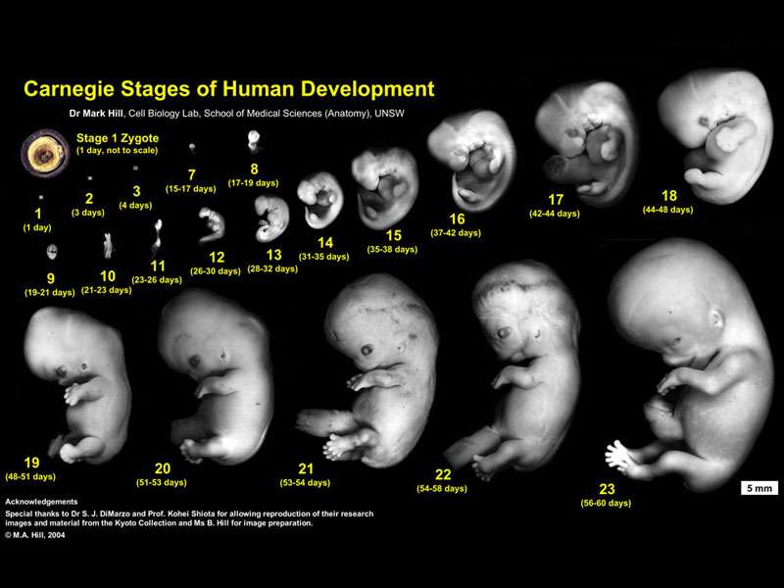
Human Development

Slide 33
How are eggs and Sperm cells formed?
Eggs and sperm cells are different than normal cells- they only have ½ of the chromosomes they’re supposed to have
Humans normally have 23 PAIRS of chromosomes that have the same GENES, but may have slightly different forms of those genes
One member of each pair comes from each parent
All chromosomes, except the ones that determine your sex, are numbered 1-22
Thus you have 2 number 1 chromosomes, 2 number 2 chromosomes, 2 number 3 chromosomes etc.

Slide 34
Karyotype

Slide 35
Eggs and Sperm
Eggs and sperm must have HALF of the number of chromosomes of normal cells- one member of each pair (homologous chromosomes)
If it has both members of each pair, it is considered diploid
If it has 1 member of each pair, it is considered haploid
Eggs and sperm are HAPLOID and are formed by a special division process known as MEIOSIS

Slide 36
Meiosis
At the end of meiosis, we get 4 HAPLOID CELLS (either 4 eggs or 4 sperm)
This occurs either in testes (male) or ovaries (female)
Each of these 4 cells is genetically DIFFERENT from the original cell because genetic information is shuffled
In meiosis, 1 cell is divided twice, thus we can split the process in half
Meiosis 1 is the first division
Meiosis 2 is the second division
They are both similar to mitosis

Slide 37
Meiosis 1
Prophase 1
Homologous chromosomes line up to form a tetrad (4 sister chromatids) and crossing over occurs to exchange genetic information
Metaphase 1
Homologous chromosomes line up down the center of the cell
Anaphase 1
Homologous chromosomes separate
Telophase 1
End up with 2 cells that are haploid

Slide 38
Meiosis 2
Same as mitosis, except you’re starting out with only ½ of the genetic information
Prophase 2
No tetrads, just 2 sister chromatids held together by centromere
Metaphase 2
Chromosomes line up in the middle
Anaphase 2
Sister chromatids are pulled apart
Telophase 2
End up with 4 haploid daughter cells

Slide 39
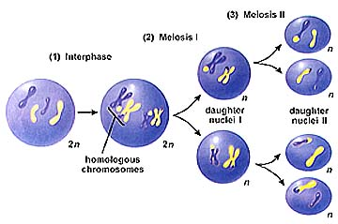
Meiosis

Slide 40
Meiosis Video

Slide 41
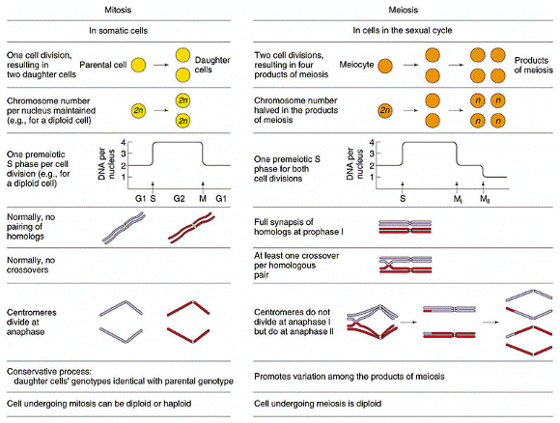
Mitosis vs. Meiosis

Slide 42
Mutations
Mutation- heritable change in genetic material
Point mutation- affects 1 base pair only
Base substitution- replace 1 base with a different one
Silent mutation- does not affect translation (amino acid sequence)
Missense mutation- changes the amino acid sequence
Nonsense mutation- changes an amino acid to a stop codon
Frameshift mutation- addition or deletion

Slide 43
Sickle Cell Disease
Beta globin gene mutation
Missense mutation
6th amino acid changed from glutamic acid (glutamate) to valine; GAG codon changed to GTG
Glutamic acid- hydrophilic, valine- hydrophobic
Resulting protein folds differently
Hemoglobins stick to each other when O₂ is low
This causes fiber-like structures within the red blood cells and they lose their shape

Slide 44
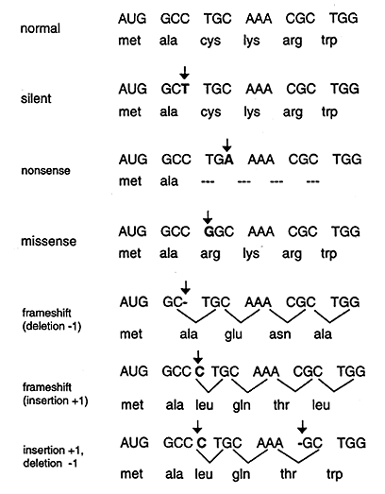
Examples

Slide 45
Mutations: Germ Line vs. Somatic
Somatic cells are all the cells in the body except the germ line cells
Germ line cells are the cells that give rise to gametes
Mutations in somatic cells only affect those somatic cells and are passed in only those cells
Mutations in the germ line cause the entire organism to carry the mutation

Slide 46
Cancer- Terms
Oncogene- A gene, that when mutated, will cause over-growth of cells
Tumor-suppressor Gene- normal gene that prevents overgrowth
Proto-oncogene- normal gene that can become an oncogene when mutated
Apoptosis- programmed cell death
Caspase- help with apoptosis
Tumor- abnormal cell growth
Malignant- cancerous tumor that has the potential to spread (metastasize)
Benign- tumor that is not cancerous

